Slide 1
MUL AND DIV
Abdul Haseeb

Slide 2
Signed vs Unsigned Multiplication
Lets take unsigned interpretation:
10000000=128
11111111=255
Result of Multiplication=32640
Lets take signed interpretation:
10000000= -128
11111111= -1
Result of Multiplication=128

Slide 3
MUL AND IMUL
Because of this problem we have two separate Instructions:
MUL
Signed Multiplication
IMUL
Unsigned Multiplication
These instructions can multiply bytes or words:
If two bytes are multiplied, result is a word
If two words are multiplied, result is a double word

Slide 4
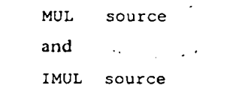
MUL AND IMUL

Slide 5
Byte Form
For byte multiplication:
One number in source (register, memory, but not a constant)
Other is assumed to be in AL
The result which will be a 16 bit, will be stored in AX

Slide 6
Word Form
For word multiplication:
One number in source
Other in the AX
Upper 16 bits in DX
Lower 16 bits in AX

Slide 7
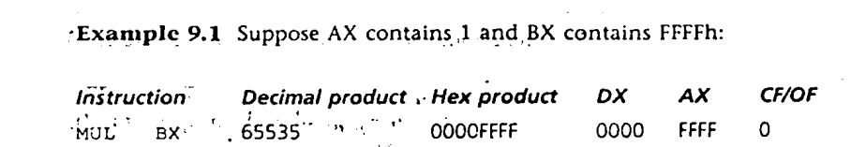
Some Examples

Slide 8
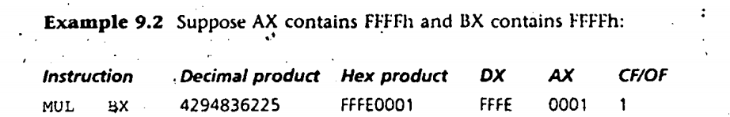
Some Examples
Notes:
FFFF=65535

Slide 9
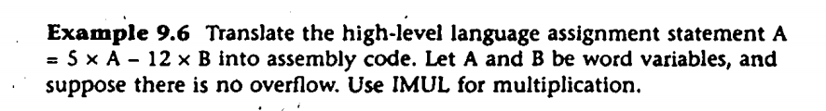
Assembly Example

Slide 10
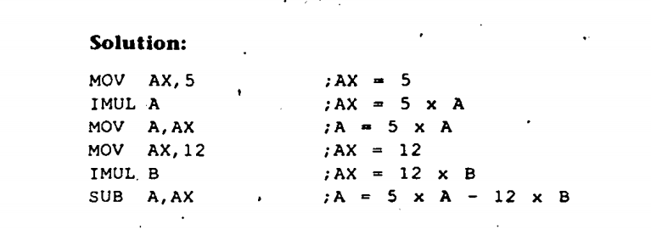
Solution

Slide 11
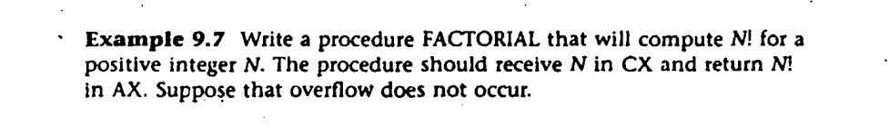
Another Example

Slide 12
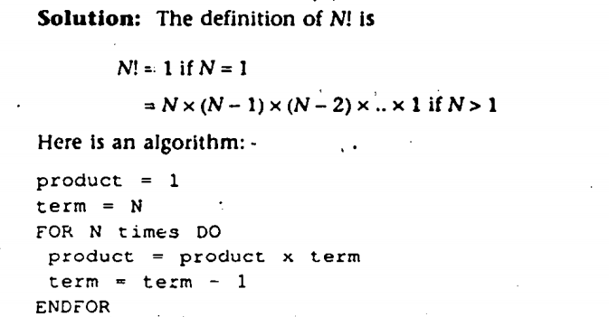
Algorithm

Slide 13
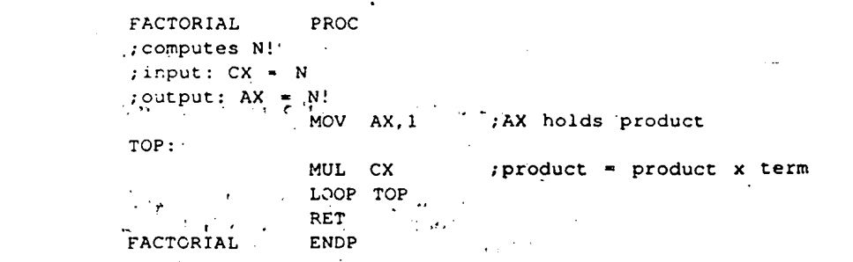
Solution

Slide 14
DIV and IDIV
After Division we obtain:
Quotient
Remainder

Slide 15
DIV and IDIV
DIV:
Unsigned Division
IDIV:
Signed Division

Slide 16
Byte Form
Divisor is 8 bit register, or memory byte
16 bit dividend is assumed to be in AX
After Division:
8 bit quotient in AL
8 bit remainder in AH

Slide 17
Word Form
Divisor is 16 bit register, or memory word
32 bit dividend is assumed to be in DX:AX
After Division:
16 bit quotient in AX
16 bit remainder in DX

Slide 18
Divide Overflow
Lets suppose we divide a very large number with very small number:
Very Large quotient
Divide Overflow
Because quotient is too large to fit in AL or AX

Slide 19
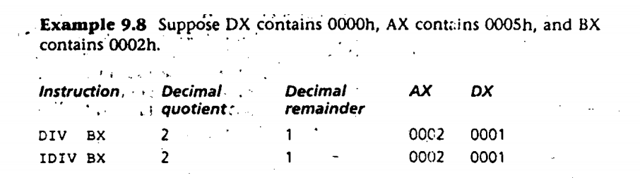
Examples

Slide 20
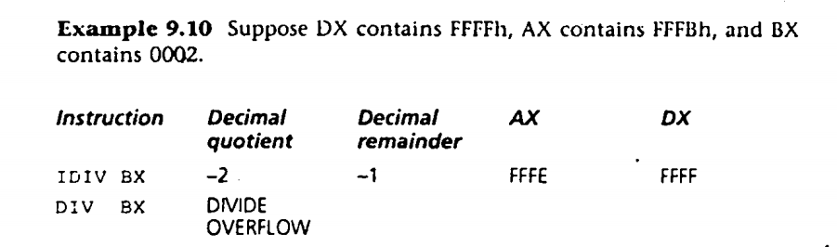
Examples

